Slide 1
Decision Tree ML
“What do you want for dinner?”
Group 1: Fourth Place
Jin Hee, Vanessa, Edward

Slide 2
Decision Tree
What does it do?
The goal of a decision tree is to create a model that predicts the value of a target variable by learning the decision rules based on the other data features provided.
The further the tree goes down, the more complex the decision rules become and the fitter the model
What dataset is this good for?
The decision tree model is good for classification and regression datasets

Slide 3
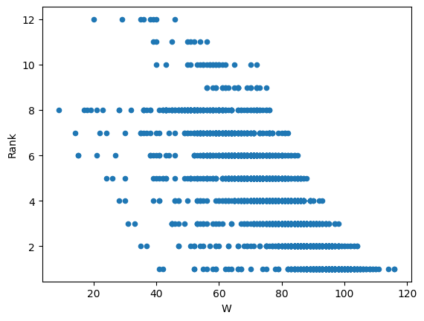
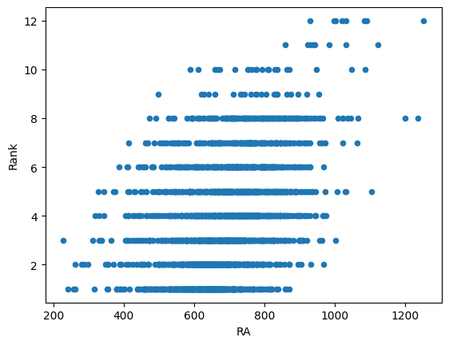
Wins vs Rank
Runs Allowed vs Rank

Slide 4
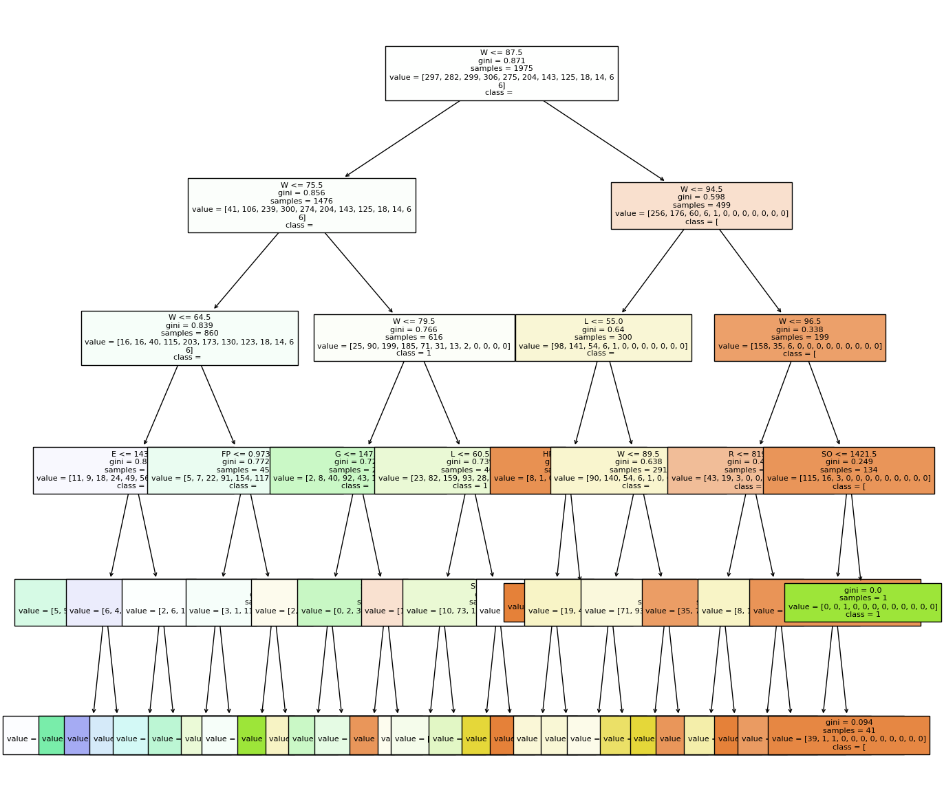

Slide 5
Advantages and disadvantages
Advantage:
Easy to understand and interpret, can capture non-linear relationship
Less effort for data preparation (does not require normalization of data)can handle both numerical & categorical data
Does not require scaling of data , missing value do not affect processing
Does not depend on the mean or variance of the data
Disadvantages:
Overfitting occurs when algorithm captures noise in the data
Inadequate for applying regression and predicting continuous values
Highly complicated decision tree tends to have a low bias which makes
it difficult for the model to work with new data/large data set

Slide 6
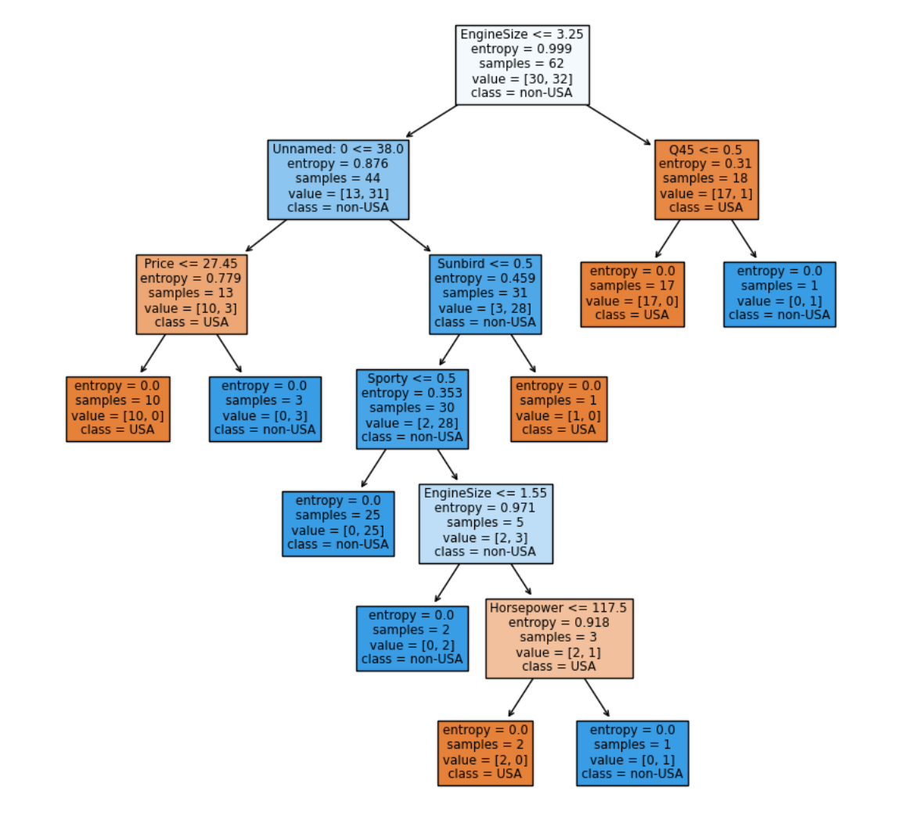
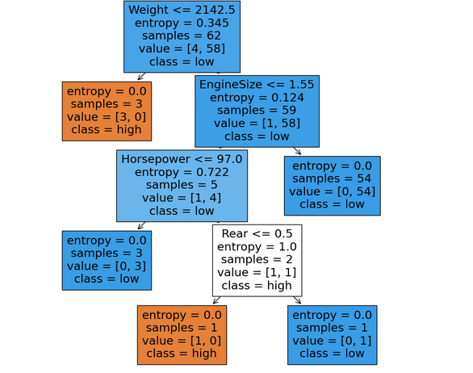
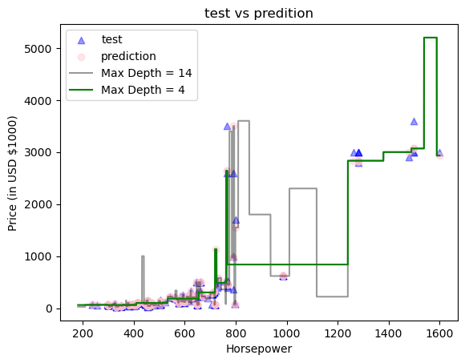
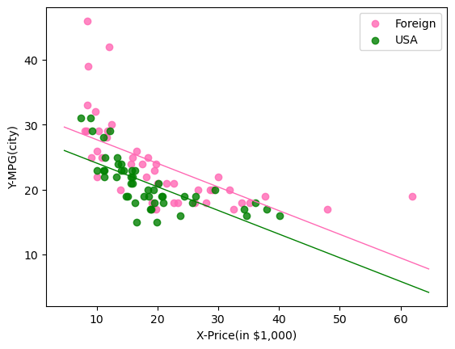
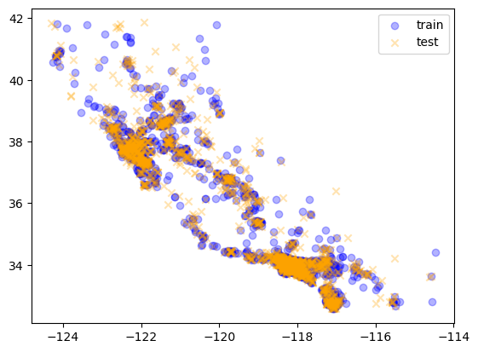
Chief Executive Officer
y = df['MPG.city']
X = df[['Price']]
model.fit(X, y)
model.score(X, y) for LinearRegression(): 0.35
model.score(X, y) for KNeighborsRegressor(): 0.73
model.score(X, y) for tree.DecisionTreeRegressor(): 0.94

Slide 7
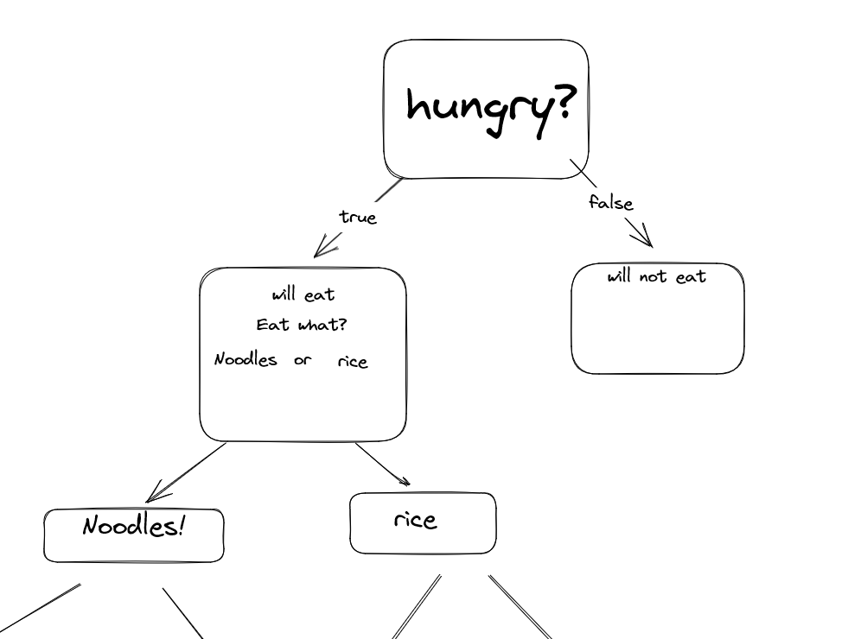
How is it understood?
A sample is split by how well it fits a given criterion of a feature.
In ML, optimum splits are based on mathematical calculations.
Gini Vs Entropy.

Slide 8

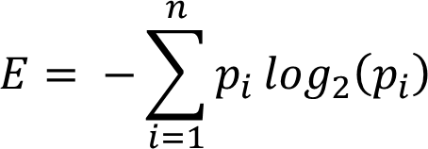
Gini vs Entropy
GiniIndex=1–∑jp2j
Gini impurity index measures the frequency at which a sample from a dataset will be mislabeled. 0 is the minimum, 0.5 is the maximum value.
Entropy is the measure of impurity in a node. 0 is the minimum, and 1 is the maximum value. Purity vs impurity.
The optimum split occurs with the value being as close to 0!

Slide 9
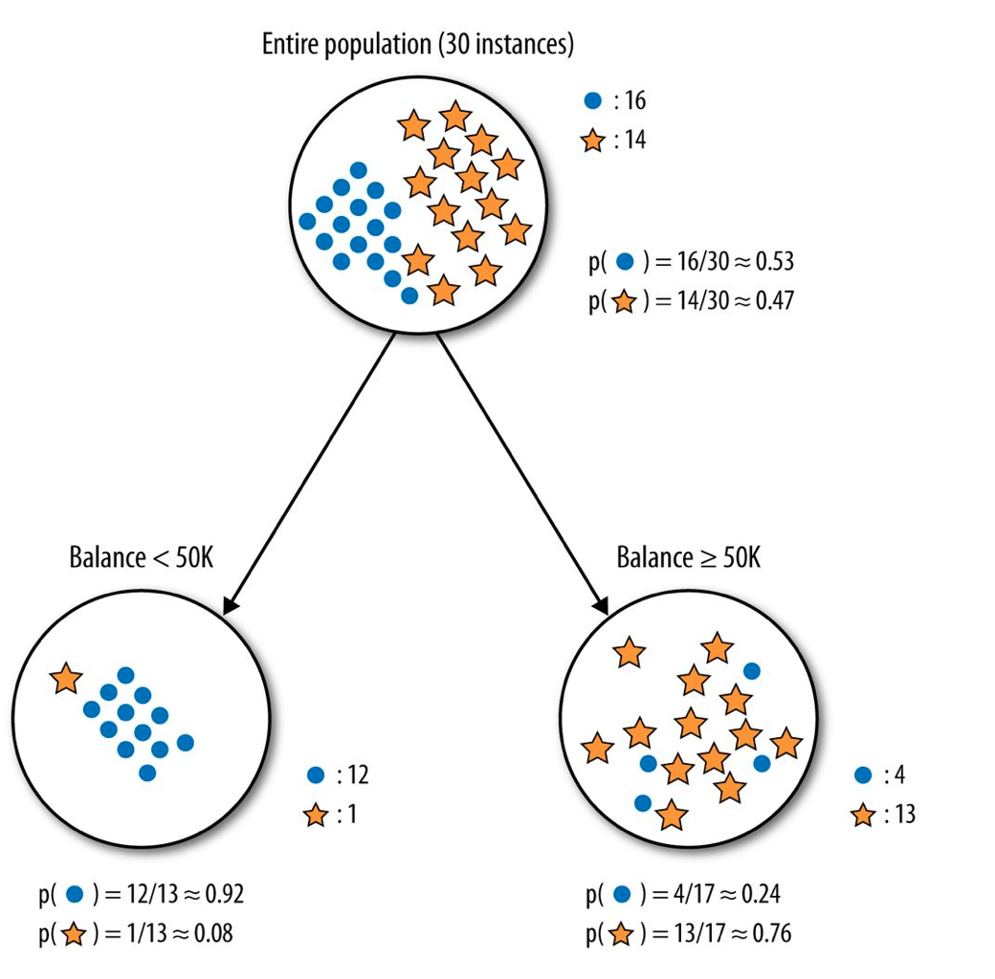
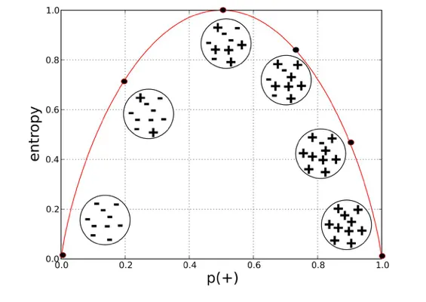
Gini vs Entropy
GiniIndex=1–∑jp2j

Slide 10
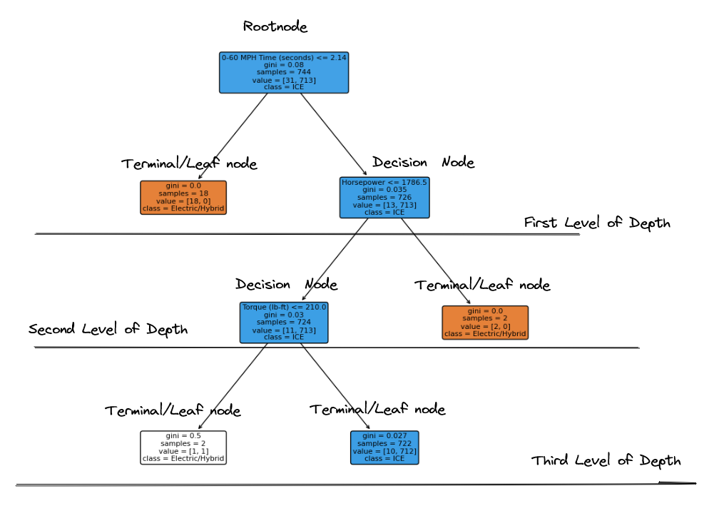
Key Terms
Root Node- initial node representing entire dataset
Interior/Decision Node- representing the dataset to be split by a condition.
Terminal/Leaf Node- representing final the outcome from a parent node.
Levels of Depth-how many splits before coming to a prediction.
Notes:
Gini = 0.5 means equal distribution of the sample.

Slide 11
Hyperparameters
DecionTreeClassifier(hyperparameters). Underlines are defaults
Which algorithm? Criterion: Gini vs entropy vs log_loss.
Splitter: random or best strategy used to split each node.
Max_depth: the maximum depth of the tree. None is the default.
Min_samples_split: minimum # of samples to split a decision node. 2 is the default.

Slide 12
Hyperparameters cont.
min_samples_leaf: minimum# of samples required at leaf/terminal node. 1 is the default.
max_features: # of features to consider for optimum split. None is the default.
max_leaf_nodes: maximum number of leaf nodes. None is the default

Slide 13
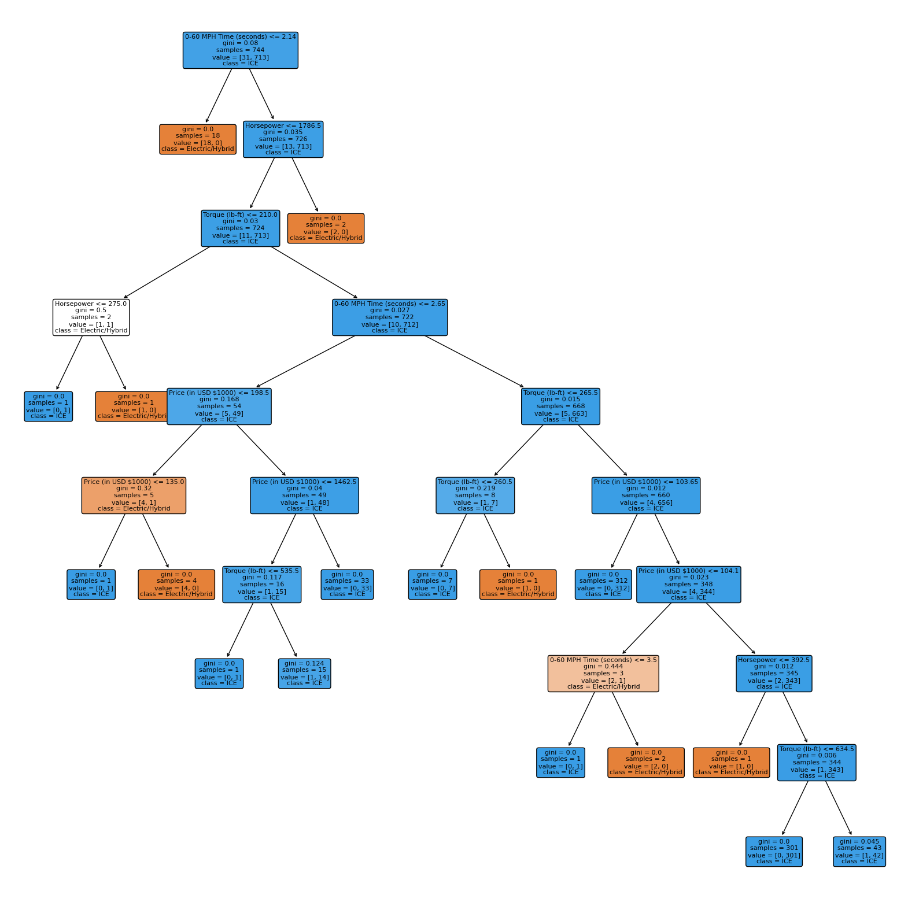
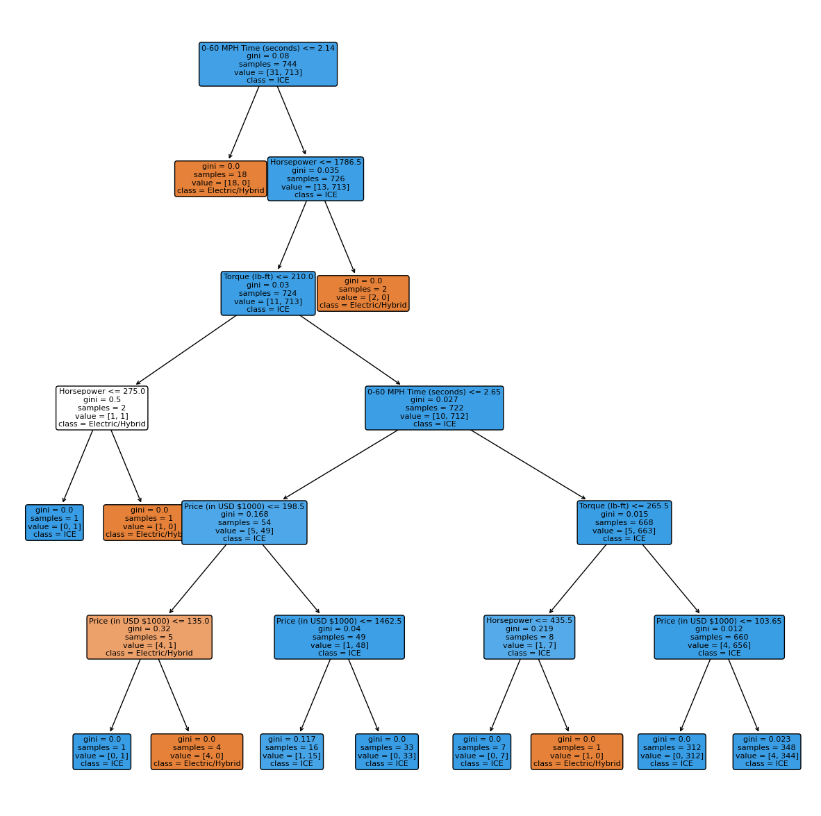
Key Terms cont.
Six Levels of Depth
Nine levels of Depth

Slide 14
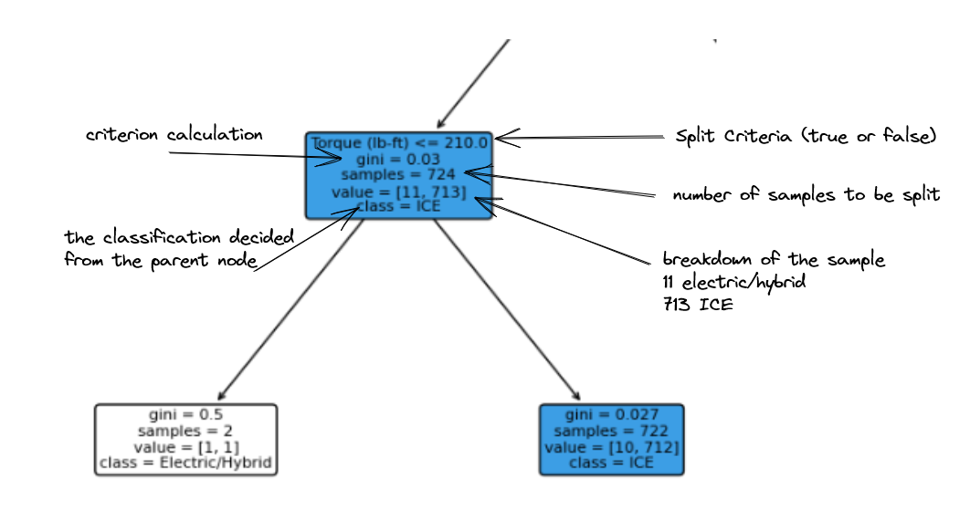
Key Terms cont.

Slide 15
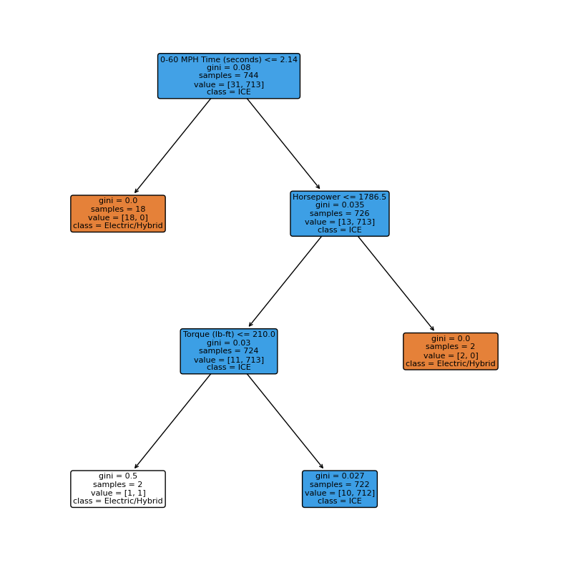
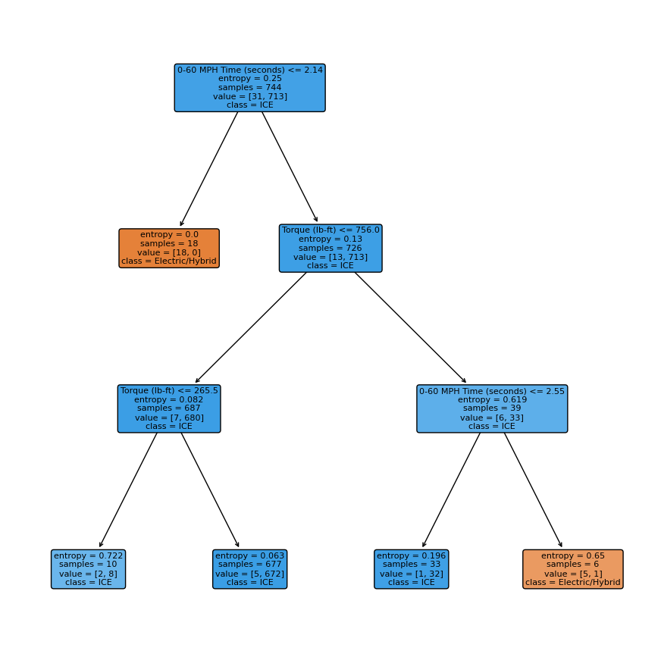

Slide 16
Resources
https://dhirajkumarblog.medium.com/top-5-advantages-and-disadvantages-of-decision-tree-algorithm-428ebd199d9a
https://www.mastersindatascience.org/learning/machine-learning-algorithms/decision-tree/
https://scikit-learn.org/stable/modules/tree.html
https://towardsdatascience.com/machine-learning-basics-decision-tree-regression-1d73ea003fda
https://quantdare.com/decision-trees-gini-vs-entropy/
https://towardsdatascience.com/entropy-how-decision-trees-make-decisions-2946b9c18c8
https://www.youtube.com/watch?v=PHxYNGo8NcI

